Slide 1
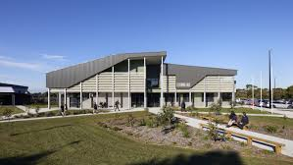

Year 9 into 10 2024
Transition Information
Wonthaggi Campus

Slide 2
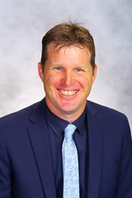
Mr Ross Bramley
Campus Principal - Wonthaggi Campus

Slide 3
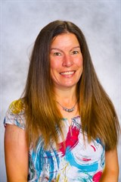
Mrs Alison Gill
Year 10 Co-ordinator

Slide 4
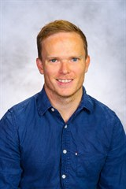
Mr Cameron Ritchie
Assistant Y10 Co-ordinator

Slide 5
We are still Bass Coast College
Classes, teachers, respect, homework, uniforms, canteen food, excursions, school sport, bus travel, …
HOWEVER…
Year 10 = last year of compulsory subjects.
We will be combining TWO campuses of Year 9 groups into the ONE-year level
More adult environment – more rights, more responsibilities, higher expectations
Change in Focus: It’s a time when students need to start thinking about Senior Pathways and a life beyond school

Slide 6
After Year 10 – Senior Pathways
Year 10 at the senior campus provides an opportunity for students to develop a clear direction for 2024 - Year 11 and beyond.
TAFE
Work Force
VCE
Year 10
Senior Pathways
VCE Vocational
Major
Traineeship
Apprenticeship

Slide 7
Year 10 SUBJECTS
2024

Slide 8
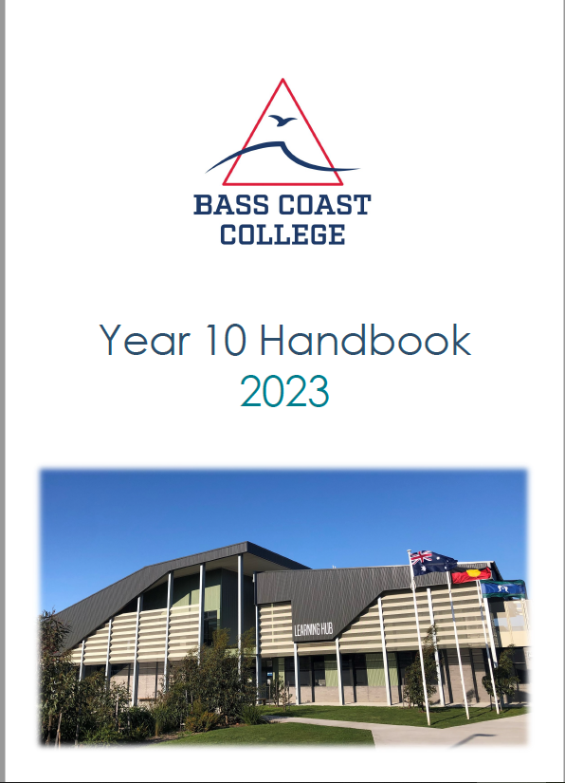
Year 10 Handbook
Subject Details
This Handbook is available on Compass Via Browser ‘Community’ Tab -School Documentation Or Bass Coast College School Website Enrolments – Transition – Year 9 into 10

Slide 9
Course Requirements
Required CORE subjects
    English
    Mathematics
    Science
    Humanities
    Art
    Technology
    Health & PE
    Then CHOOSE a further 3 x Electives which can be chosen from Science, Humanities, Art, Technology and Health & PE
Must choose one of each of these CORE subject topics
Must choose one of each of these subjects as ELECTIVE subjects

Slide 10
The Course Structure in 2024

Slide 11
Pathways Summary
To assist with subject selection there are Pathways Summaries for all Key Learning Areas at the back of the Student handbook

Slide 12

English in Year 10
Remains a compulsory subject - All the way to Year 12
English is a core subject and must be completed by all students in Semester 1&2.
ELECTIVE SUBJECT/S:
  English Literature/Advanced is offered as a semester based elective for students seeking extension in English

Slide 13

Maths in Year 10
Remains a compulsory subject
Maths is a core subject and must be completed by all students in Semester 1&2.

Slide 14

Yr 10 Maths Subjects 2023
FUNDAMENTAL – sound preparation for VCE V/M
MAINSTREAM PRE GENERAL – sound preparation for VCE General Maths and VCE V/M
MAINSTREAM PRE METHODS – best preparation for VCE maths
MATHS EXTENSION – extension Maths subject for SEAL students
ELECTIVE MATHS SUBJECT:
  Mathematics Elective Pre-Calculus elective for students seeking further extension in Mathematics in preparation for VCE level maths subjects

Slide 15
Which level Maths to Choose?
Students will be advised by their Year 9 Maths teachers as to which level of maths to select.
Students should also consider possible pathways and the maths level that best supports their pathway.

Slide 16

Science in Year 10
Science is still a CORE course Key Learning Area, the requirement is to complete at least one Science subject.
Offered as a choice of five semester long Subjects.
Students MUST choose one Science subject, however can choose more as an ELECTIVE.

Slide 17
Science Subjects Available
The Year 10 Science units available are:
  Psychology & Biology
  Physics & Chemistry
  Physics & Environmental Science
  Biology & Chemistry
  Biology & Environmental Science
** Each subject covers a different aspect of the topics; e.g. each subject with Biology for instance will cover different aspects of the Biology topic.

Slide 18

Humanities in Year 10
Humanities is still a CORE course Key Learning Area, the requirement is to complete at least one Humanities subject.
Humanities is offered as a choice of four Semester long Subjects.
Students MUST choose one Humanities subject, however can choose another as an ELECTIVE.

Slide 19
Humanities Subjects Available
The Year 10 Humanities subjects available are:
  Making and Breaking the Law
  Changing the World
  Taking Care of Business
  The Making of Modern Australia – War, Rights & Freedoms
** Each subject is a stand alone subject in Humanities and each links through to a VCE pathway – see the Pathways Summary in the Handbook

Slide 20
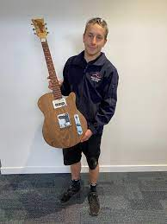
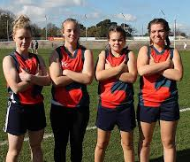
What other subjects can I study in Year 10?
Student are also required to choose from one of :
  Arts
  Health & PE
  Technology

Slide 21
Electives
  Electives can be chosen from the following Key Learning Areas:
  Science
  Humanities
  Technology
  Arts
  Health & Physical Education
  Languages
  Music – basic and advanced pathways
  Mathematics/English (elective subjects)
For information on the specific subjects offered please refer to the Handbook on the College Website
All Learning Areas have electives available

Slide 22
Are VCE or VET Subjects Available to Year 10 Students?
Yes - this was partly behind the revamp of the Year 10 Curriculum to provide access to VCE subjects to allow extension for Year 10 students
Available for students seeking an extension to their studies
Students should only attempt these subjects if they have a specific interest and ability in the topic

Slide 23
However…
Subject to availability** - Year 11 students do have priority to Year 11 subjects
Students should understand there is a greater academic rigour required to complete VCE subjects, which are examinable
Some subjects may be better attempted in Year 11 & 12
Students will need to meet certain selection criteria for early access to VCE subjects, including approval from Year 9 subject teacher.
Should not be viewed as a shortcut for Year 11 & 12.

Slide 24
The Subject Selection Process
The Year 10 Subject Selection Process is now run Online using Edval program
  Students will instructed on this process by their Year 9 Coordinators and Teachers
  Students will be provided with a Edval Webcode to access the Online selection process
Selections must be completed by Friday 18th August, 2023

Slide 25
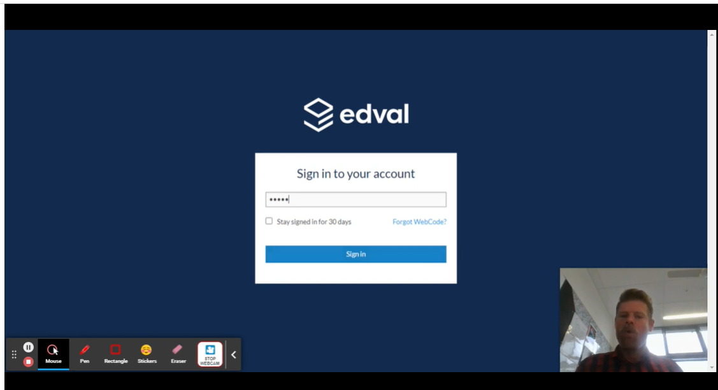
How to Select your Year 10 Subjects Online
There is a video created by Jesse Boyd that outlines the Online Subject Selection Process available
  Yr 9 into10 Transition on the College Website – ‘How to Select your Year 10 Subjects’

Slide 26
Who can help me with my transition to Year 10?
Alison Gill– Year 10 Co-ordinator
Cameron Ritchie– Assistant Year 10 Co-ordinator
Dudley and San Remo Year 9 Co-ordinators
Ross Bramley– Campus Principal
Phil Hughes - Assistant Campus Principal / VCE Coordinator
Jim Lees - VET Coordinator
Wellbeing Team

Slide 27

Bring Your Own Device Policy
Netbooks / Laptops Are Advised
Can be purchased through the school WSC Laptop Portal.
6-7 PC options
Starting around the $600 mark – even less with a Health Benefits Card

Slide 28
Parents ‘What do we do now?’
Read
Read the Year 10 Handbook with your child to familiarise your selves with your subjects.
Discuss
Discuss subjects the subjects your child is interested.
Consider
Consider their strengths and possible pathway – for 2024 and beyond.
Identify
Identify the subjects your child may wish to study and some backup subjects.
Keep
Keep an eye out for their ‘webcode’ used to access online subject selections. Students School Email Account
Assist
Assist your child to complete online subjects selections by the deadline.

Slide 29
The TIMELINE for transition to Wonthaggi Campus in 2024?
T3 Weeks 1-3: Student Information Sessions at San Remo & Dudley led by KLA leaders.
Monday 31st July: Parent Information Evening – San Remo Campus.
Wednesday 2nd August: Parent Information Evening - Wonthaggi Campus Library
Friday 18th August: CLOSE Subject Selections Online
End Term 3: Course Counselling & Finalisation
Mid Term 4: Subjects Confirmation
4th – 8th December: Start of the Year 10 program – Wonthaggi Campus
30 January 2024: Students start School Commences 2023

Slide 30

Thank you for your attention

